Slide 1
Why Are Some Herbicides Not Recommended By UGA?
Eric P. Prostko and A. Stanley Culpepper
Professors/Extension Weed Specialists
Dept. Crop & Soil Sciences

Slide 2
U.S. Crop Production – 2015 Acres Planted (X 1000)
Source: NASS - Crop Production (November 2015)

Slide 3
Cotton vs. Soybean in SE
1,275,000 acres harvested in 2015
1.6% of US Total
1,720,000 acres harvested in 2015
21.1% of US Total
Source: USDA/NASS, Crop Production (November 2015)

Slide 4
Herbicide Advertisements
Progressive Farmer - November 2015

Slide 5
Herbicides You Might Not Be Too Familiar With

Slide 6
Reasons for Not Recommending
limited data
would prefer 2-3 years of data
43 peanut trials with pyroxasulfone (Zidua)
crop injury
carryover
weed efficacy
Texas panicum
cost/A
any better than current standards?

Slide 7
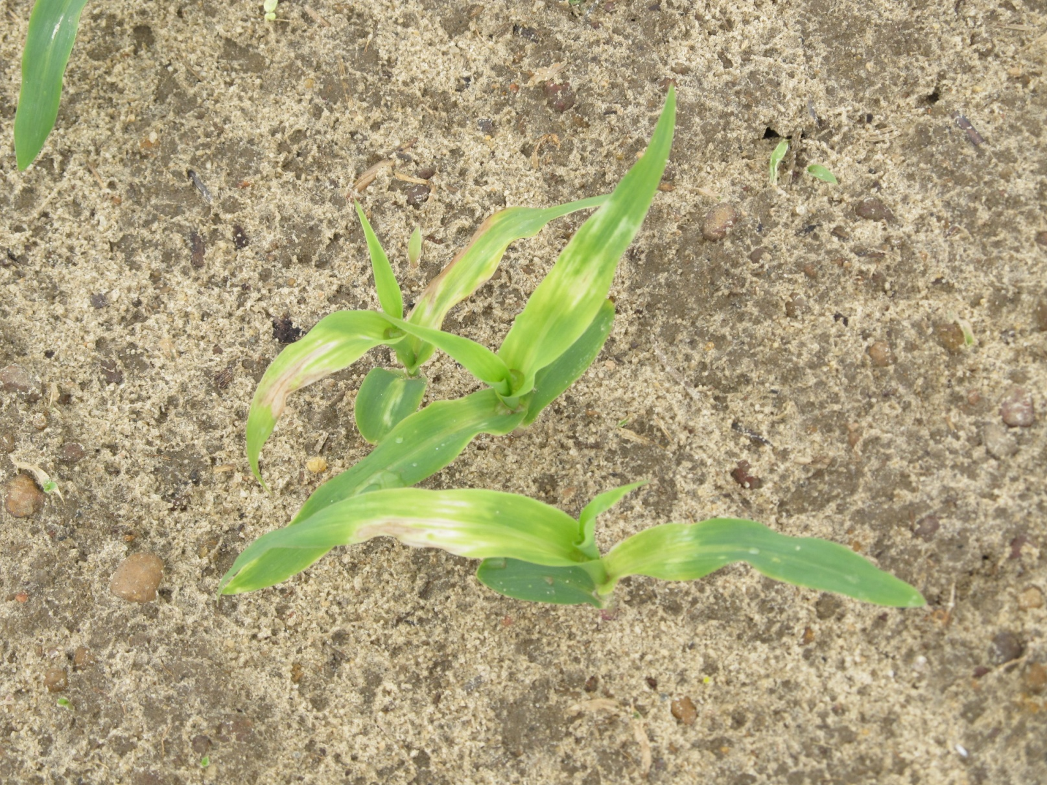
PRE Applied Balance Flexx Injury on Field Corn
CN-10-12
April 6
11 DAT

Slide 8
Peanut Injury with Anthem Flex 4SE – 22 DAT
NTC
3.0 oz/A
3.75 oz/A
6.0 oz/A
7.5 oz/A
PE-01-15
May 19

Slide 9
Peanut Yield Response to PRE Applications of Anthem Flex - 2015
LSD 0.10 = 906
CV = 13.06
PE-01-15
Weed-free
Anthem Flex 4SE = pyroxasulfone (3.733 lbs) + carfentrazone (0.267 lbs)

Slide 10
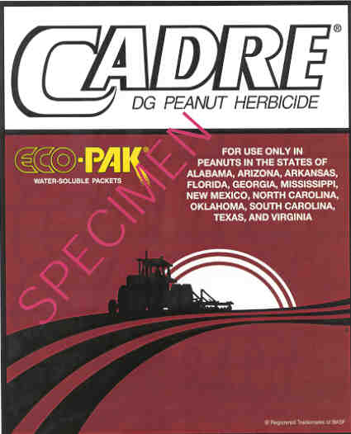
Cadre vs. Flame in Peanut
imazapic
Cadre - US
Flame – Australia
Flame registered for PRE/POST us in peanut
Cadre Registered for POST use only
WHY??
Increased rotational crop issues (i.e. cotton)
less control of Florida beggarweed

Slide 11
Soil Types Southeast vs. Midwest
 | Ponder Farm - UGA | South Charleston, OH | Concord, NB | Ames, IA
Soil Texture Class | loamy sand | silty clay loam | silty clay loam | clay loam
% OM | 0.77 | 3.0 | 2.8 | 5.5
CEC (meq/100g) | 2.6 | 19.5 | 19.7 | 30.6
Sand (%) | 92 | 0-20 | 10 | 20-45
Silt (%) | 6 | 60-70 | 58 | 15-55
Clay (%) | 2 | 30-40 | 32 | 25-40

Slide 12
Midwest Weed Control Programs
Soybeans
PPLNT | PRE | POST1 | POST2
Valor XLT + 2,4-D + Glyphosate |  | Glyphosate + Flexstar | Glyphosate
Canopy + Sencor + 2,4-D + Glyphosate |  | Glyphosate + Cobra | Glyphosate
Glyphosate + Sharpen |  | Glyphosate + Warrant | Glyphosate + Cobra
Field Corn
PRE | POST
Lumax or Lexar (2/3rd rate) | Glyphosate + Distinct, Impact, or Laudis
Corvus or Verdict + atrazine | Roundup or Liberty
Atrazine premix (2/3rd rate) | Glyphosate + Distinct, Impact, or Laudis, Halex GT
Source: Dr. Bill Johnson, Purdue University (11/12/2015)

Slide 13
Bottom Line
usually a very good reason why herbicides are not recommended by UGA or listed in Pest Control Handbook
do not assume a label in another state/country will work in GA!

